Slide 1
What nhl teams performed the best and worst during the 2010’S?
Final Project for SAL 603
By Michael Wilson

Slide 2
data
All data came via evolving-hockey.com
Imported data for team standings from 2010-2019
To best judge team points over the decade created a column for pts/82 games played to account for the 48 games during the 2012-13 season
Imported underlying numbers for teams from 2010-2019
This included stats like expected goals for, expected goals against, corsi for and corsi against

Slide 3
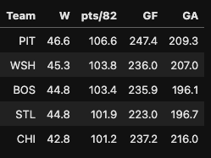
The Best
Every team that was in the top 5 in pts/82 games per season won the Stanley Cup at least once
The Blackhawks and Penguins each won multiple Stanley Cups during the decade

Slide 4
Bar plot of pts/82
Pittsburgh lead the way in total points
Buffalo is still trying to find its way back to relevancy
Teams like EDM, COL and CAR saw their fortunes change in the next decade
Vegas quickly established themselves as a top team in the league

Slide 5
Goals for/against
Kings, Bruins and Blues were routinely surrendered the fewest goals each season
Penguins and Lightning consistently among the highest scoring teams
Devils and Sabres spent the decade trying to learn how to score

Slide 6
xGoals for/against
Rangers, Islanders and Hurricanes generated a lot of offense but put a lot of stress on their goalies
Sharks were the analytics team of the decade but had no Cup to show for it
Devils and Wild were stellar defensively but struggled to generate offense

Slide 7
Shot Suppression & creation
Devils kept anything from happening on the ice, either for them or against them
Kings and Bruins were dominant at both ends of the ice
Rangers were a Cup contender in the early part of the decade but did not have the underlying numbers to support it

Slide 8
Shooting and Goaltending
Bruins, Capitals and Rangers saw supreme goaltending that earned Vezina trophies
Lightning displayed league best finishing talent
Flames and Oilers worst goaltending of the decade

Slide 9
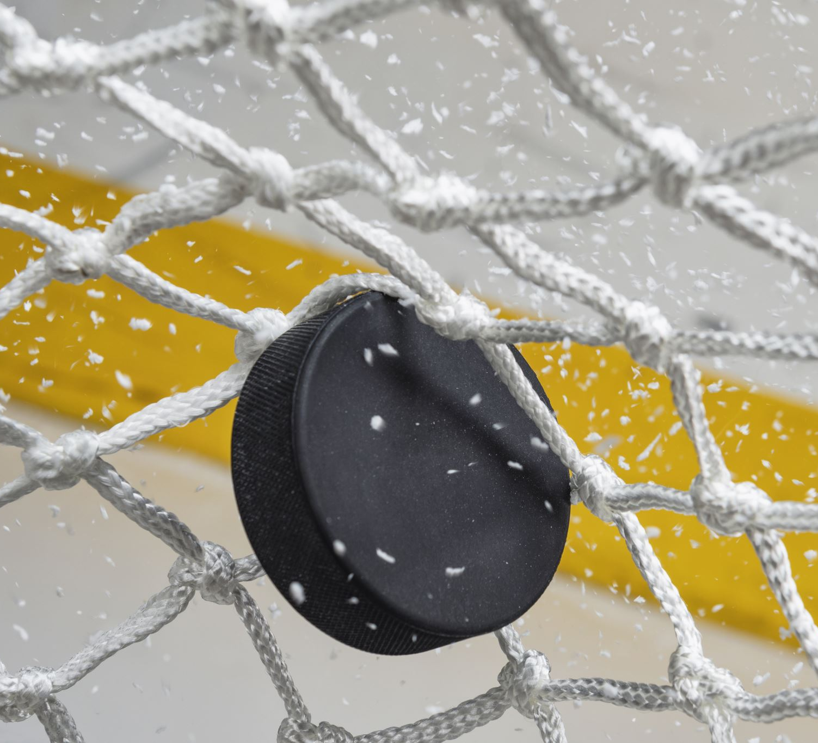
Conclusion
The 2010s saw great success for teams like the Penguins, Bruins and Capitals who carried that success into the early part of the 2020s
Teams that spent the decade at the bottom of the league like the Oilers, Avalanche and Panthers saw their fortunes turn in the next decade with the Panthers and Avalanche each winning the Stanley Cup
The Sabres have yet to be able to climb their way out of the basement of the league

